Slide 1
DSC640 Weekly Assignment
Week 1 & 2
Edris Safari

Slide 2
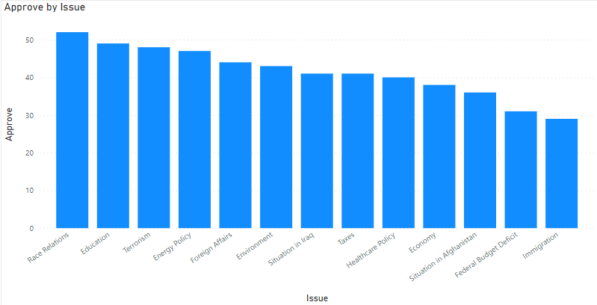
PowerBI Bar Chart

Slide 3
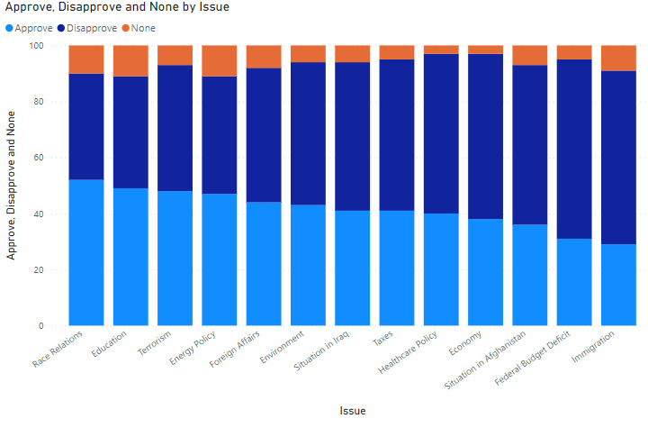
PowerBI Stacked Bar Chart

Slide 4
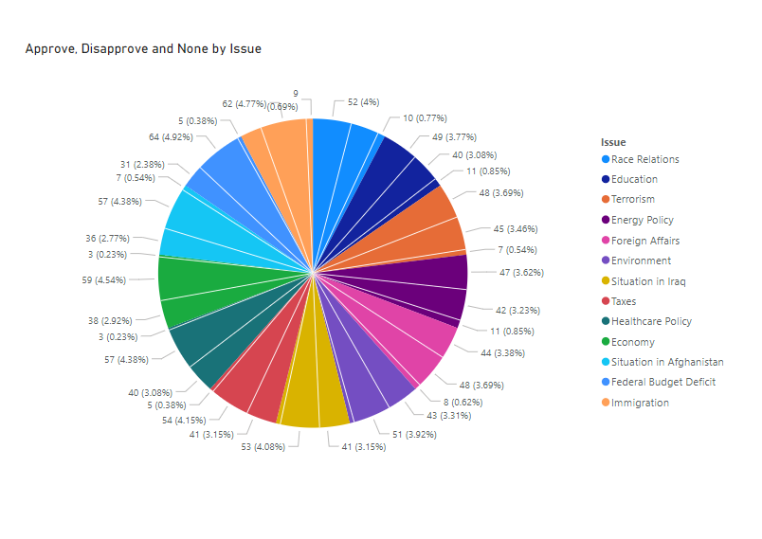
PowerBI Pie Chart

Slide 5
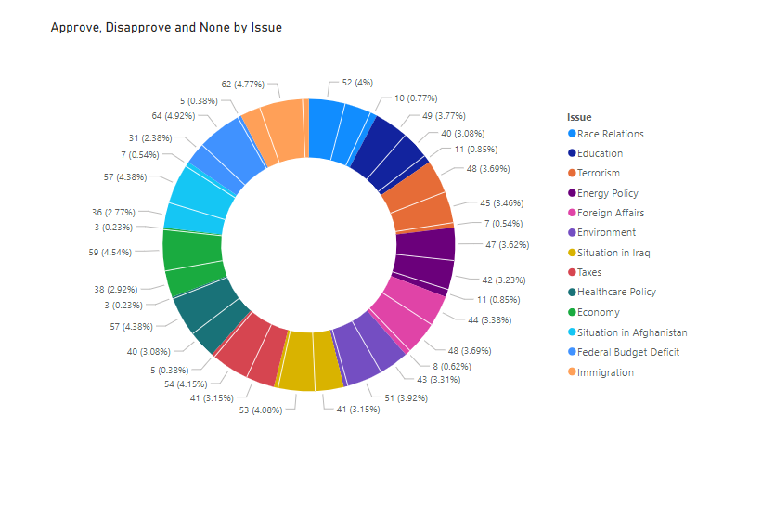
PowerBI Donut Chart

Slide 6
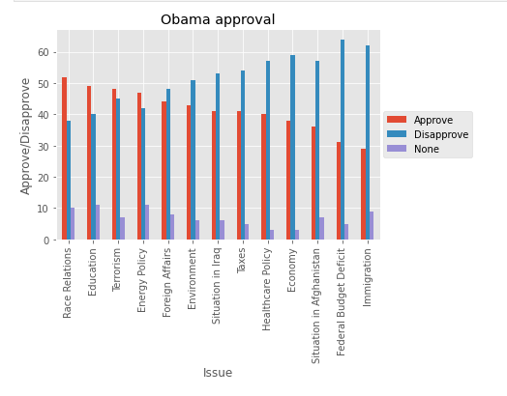
Python Bar Chart

Slide 7
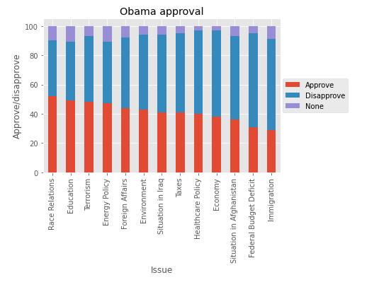
Python Stacked Bar Chart

Slide 8
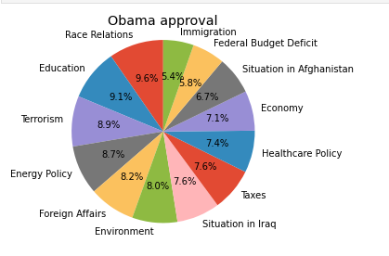
Python Pie Chart

Slide 9
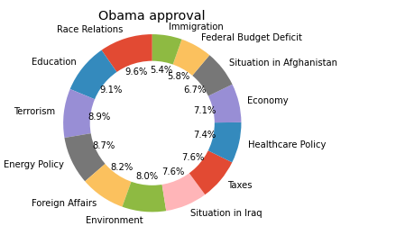
Python Donut Chart

Slide 10
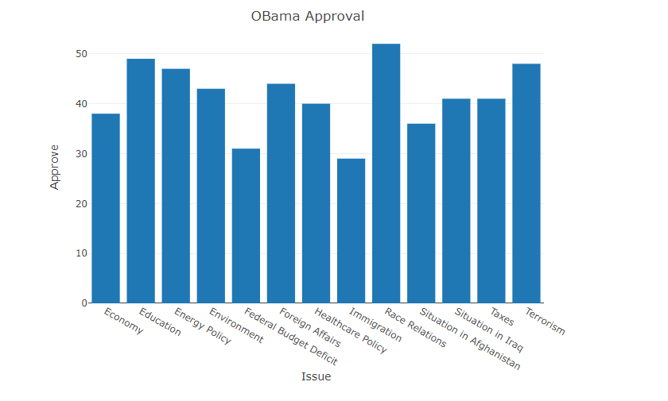
R Bar Chart

Slide 11
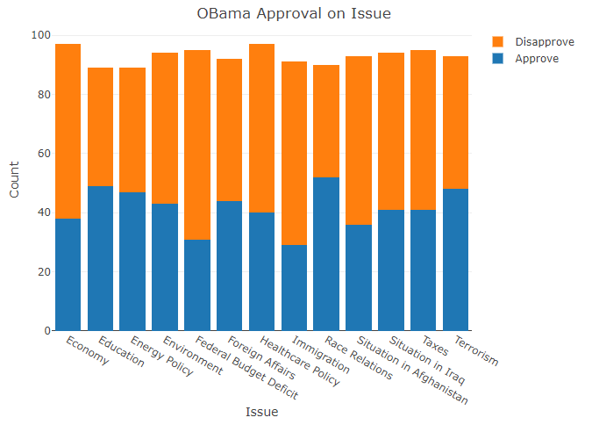
R Stacked Bar Chart

Slide 12
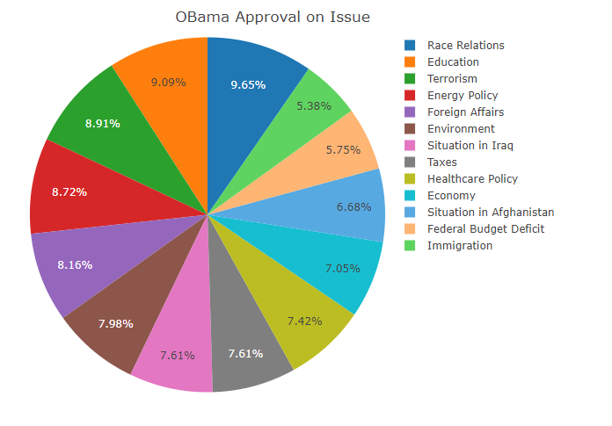
R Pie Chart

Slide 13
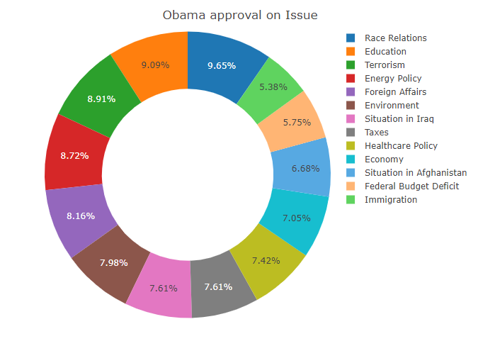
R Donut Chart

